Slide 1
WLAN Standards

Slide 2
802.11 WLAN Standards
WLANs work at OSI Layers 1 and 2
They support TCP/IP higher-layer OSI protocols and operating systems
Most popular standards used by WLANs is referred to as Wi-Fi (wireless fidelity)
Notable Wi-Fi standards
802.11b, 802.11a, 802.11g, 802.11n, 802.11ac, and 802.11ax
802.11n and later modify the way frames are used at the MAC sublayer (lower portion of the Data Link layer)
The LLC sublayer is primarily concerned with multiplexing, flow and error control, and reliability

Slide 3
802.11 Innovations (1 of 3)
Several innovations have been implemented that contribute to making later 802.11 standards much faster and much more reliable:
Channel bonding – two adjacent 20-MHz channels can be bonded to make 40-MHz channel
It more than doubles the bandwidth available in single 20-MHz channel

Slide 4
802.11 Innovations (1 of 3)
MIMO (multiple input-multiple output) – multiple access point and client device antennas may issue signal to one or more receivers
MIMO increases range and a network’s throughput
MU-MIMO (multiuser MIMO) – a newer technology that allows multiple antennas to service multiple clients simultaneously
MU-MIMO reduces congestion and contributes to faster data transmission
MU-MIMO is available with WAVE 2 802.11ac products

Slide 5
802.11 Innovations (2 of 3)
Several innovations have been implemented that contribute to making later 802.11 standards much faster and much more reliable (continued):
OFDMA (Orthogonal Frequency Division Multiple Access) – supports more efficient multiuser functionality for 80211 ax devices
Frame aggregation combines multiple frames into one larger frame
Networks can use one of two techniques for combining multiple data frames:
A-MSDU (Aggregated Mac Service Data Unit)
A-MPDU (Aggregated Mac Protocol Data Unit)

Slide 6
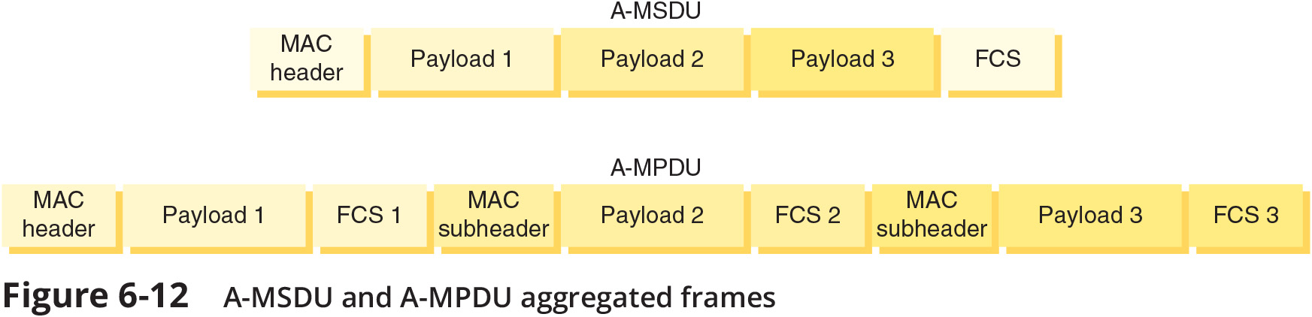
802.11 Innovations (3 of 3)

Slide 7
Access Method (1 of 2)
802.11 MAC services append 48-bit physical addresses to frame to identify source and destination
The use of the same physical addressing scheme as other Ethernet networks allows easy combination with other IEEE networks
Wireless devices are not designed to simultaneously transmit and receive

Slide 8
Access Method (1 of 2)
802.11 standards specify the use of CSMA/CA (Carrier Sense Multiple Access with Collision Avoidance) procedures to access a shared medium
Uses ACK packets to verify every transmission and requires more overhead than 802.3
RTS/CTS (Request to Send/Clear to Send) protocol ensures packets are not inhibited by other transmissions
RTS/CTS decreases network efficiency, but can be efficient for large transmission packets

Slide 9
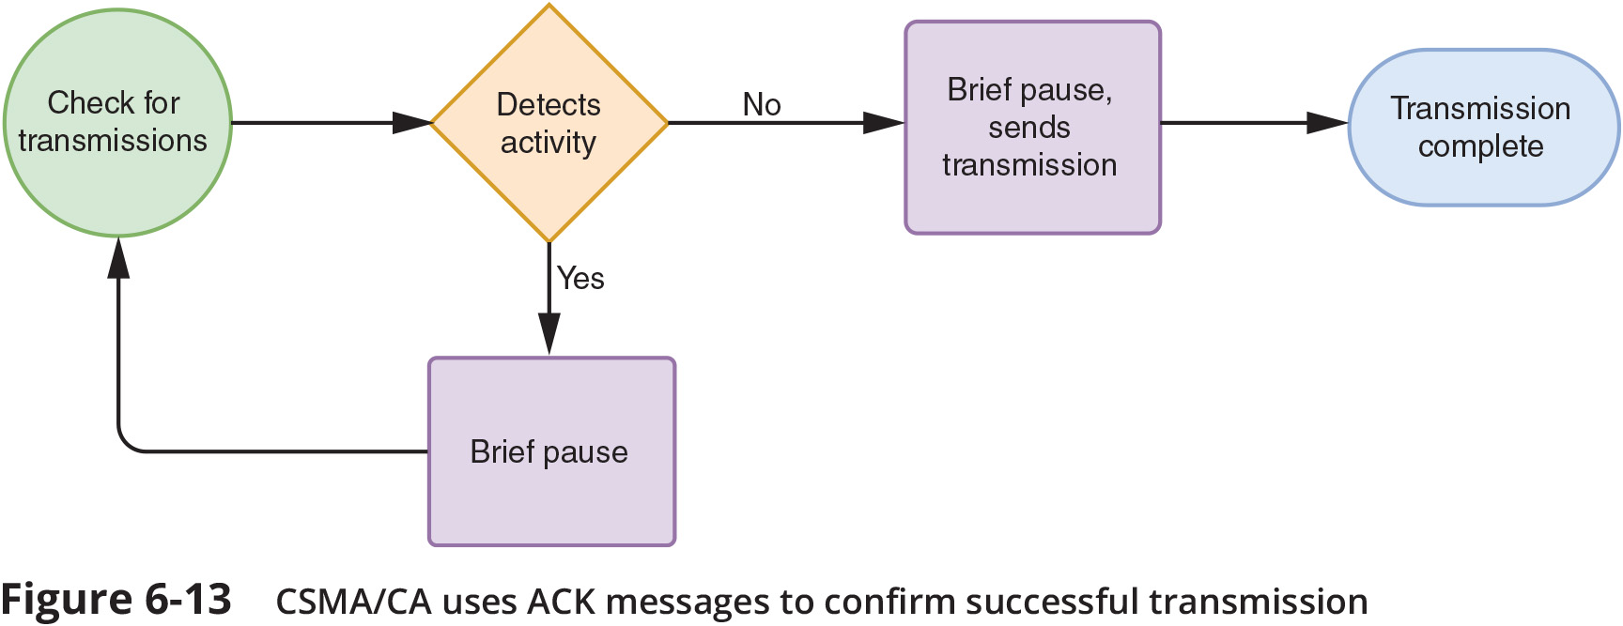
Access Method (2 of 2)

Slide 10
Association and Wireless Topologies (1 of 3)
Association is the process where packets are exchanged between computer and an access point in order to gain Internet access
Scanning occurs when a wireless devices surveys its surroundings for an access point
In active scanning the wireless client takes the initiative by transmitting a special frame known as a probe
In passive scanning the AP takes the initiative
The wireless devices listens for special signal known as a beacon fame

Slide 11
Association and Wireless Topologies (1 of 3)
SSID (service set identifier) is a unique character string identifying an access point
The SSID is contained in the beacon frame information
The SSID is configured in the AP’s configuration utility, and it is recommended that it be changed from the default setting

Slide 12
Association and Wireless Topologies (2 of 3)
IEEE terms that reflect the most common wireless topologies include the following:
IBSS (Independent basic service set) using an ad hoc topology – a small number of nodes closely positioned transmit directly to each other without an intervening connectivity device
BSS (basic service set) using an infrastructure topology – a group of stations share an access point
The identifier for this group of nodes is known as a BSSID (basic service set identifier)

Slide 13
Association and Wireless Topologies (2 of 3)
ESS (extended service set) using a mesh topology – several access points are connected to same LAN network
These APs are configured and managed by a wireless LAN controller
Clients that belong to the same ESS share a special identifier called an ESSID (extended service set identifier)
The ESSID allows a user to roam, or change from AP to AP

Slide 14
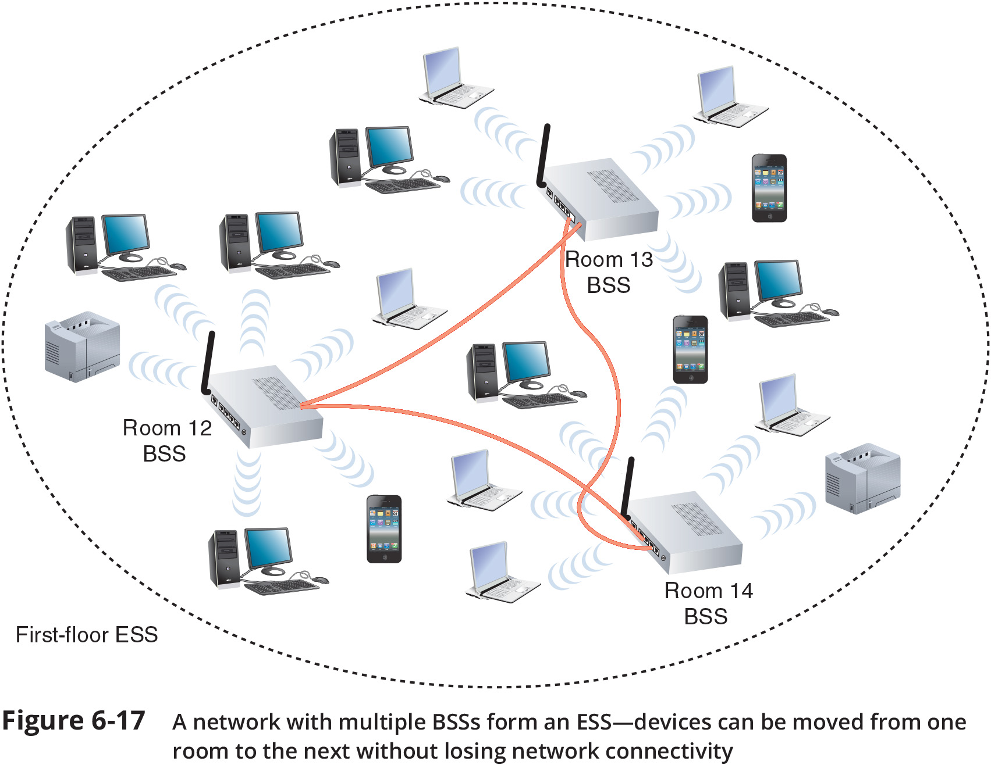
Association and Wireless Topologies (3 of 3)

Slide 15
IEEE 802.11 Frames (1 of 2)
802.11 specifies a MAC sublayer frame type
These frame types are divided into three groups:
Management frames – association and reassociation
Control frames – medium access and data delivery
Examples of control frames include ACK and RTS/CTS frames
Data frames – carry data sent between stations

Slide 16
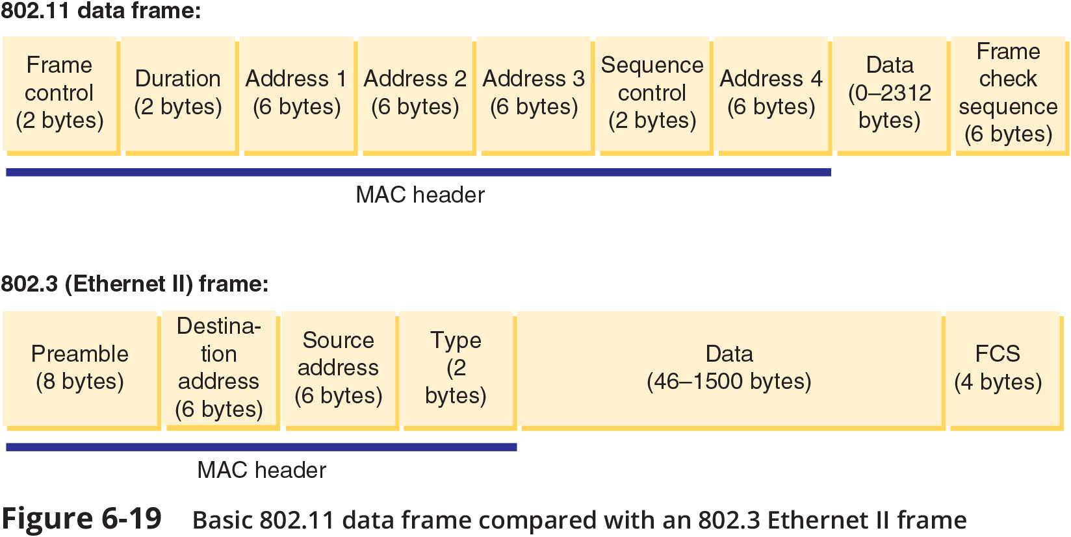
IEEE 802.11 Frames (2 of 2)

